Slide 1
Module 8: Single-Area OSPF
Enterprise Networking, Security, and Automation v7.0
(ENSA)
Notes:
Cisco Networking Academy Program
Enterprise Networking, Security, and Automationv7.0 (ENSA)
Module 1: Single-Area OSPFv2 Concepts

Slide 2
Module Objectives
Module Title: Single-Area OSPF Concepts
Module Objective: Explain how single-area OSPF operates in both point-to-point and broadcast multiaccess networks.
Topic Title | Topic Objective
OSPF Features and Characteristics | Describe basic OSPF features and characteristics.
OSPF Packets | Describe the OSPF packet types used in single-area OSPF.
OSPF Operation | Explain how single-area OSPF operates.
OSPF Router ID | Configure an OSPFv2 router ID.
Point-to-Point OSPF Networks | Configure single-area OSPFv2 in a point-to-point network.
Modify Single-Area OSPFv2 | Implement modifications to change the operation of single-area OSPFv2.
Notes:
2
1 – Single-Area OSPFv2
1.0.2 – What will I learn to do in this Module?

Slide 3
8.1 OSPF Features and Characteristics
Notes:
1 - Single-Area OSPFv2 Concepts
1.1 - OSPF Features and Characteristics

Slide 4
OSPF Features and Characteristics Introduction to OSPF
OSPF is a link-state routing protocol that was developed as an alternative for the distance vector Routing Information Protocol (RIP). OSPF has significant advantages over RIP in that it offers faster convergence and scales to much larger network implementations.
OSPF is a link-state routing protocol that uses the concept of areas. A network administrator can divide the routing domain into distinct areas that help control routing update traffic.
A link is an interface on a router, a network segment that connects two routers, or a stub network such as an Ethernet LAN that is connected to a single router.
Information about the state of a link is known as a link-state. All link-state information includes the network prefix, prefix length, and cost.
Notes:
1 - Single-Area OSPFv2 Concepts
1.1 - OSPF Features and Characteristics
1.1.1 - Introduction to OSPF

Slide 5
OSPF Features and Characteristics Components of OSPF
All routing protocols share similar components. They all use routing protocol messages to exchange route information. The messages help build data structures, which are then processed using a routing algorithm.
Routers running OSPF exchange messages to convey routing information using five types of packets:
Hello packet
Database description packet
Link-state request packet
Link-state update packet
Link-state acknowledgment packet
These packets are used to discover neighboring routers and also to exchange routing information to maintain accurate information about the network.
Notes:
1 - Single-Area OSPFv2 Concepts
1.1 - OSPF Features and Characteristics
1.1.2 - Components of OSPF

Slide 6
OSPF Features and Characteristics Components of OSPF (Cont.)
OSPF messages are used to create and maintain three OSPF databases, as follows:
Database | Table | Description
Adjacency Database | Neighbor Table | List of all neighbor routers to which a router has established bi-directional communication. This table is unique for each router. Can be viewed using the show ip ospf neighbor command.
Link-state Database (LSDB) | Topology Table | Lists information about all other routers in the network. The database represents the network LSDB. All routers within an area have identical LSDB. Can be viewed using the show ip ospf database command.
Forwarding Database | Routing Table | List of routes generated when an algorithm is run on the link-state database. Each router's routing table is unique and contains information on how and where to send packets to other routers. Can be viewed using the show ip route command.
Notes:
1 - Single-Area OSPFv2 Concepts
1.1 - OSPF Features and Characteristics
1.1.2 - Components of OSPF (Cont.)

Slide 7
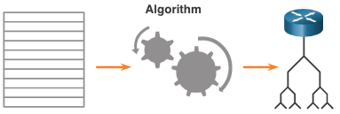
OSPF Features and Characteristics Components of OSPF (Cont.)
The router builds the topology table using results of calculations based on the Dijkstra shortest-path first (SPF) algorithm. The SPF algorithm is based on the cumulative cost to reach a destination.
The SPF algorithm creates an SPF tree by placing each router at the root of the tree and calculating the shortest path to each node. The SPF tree is then used to calculate the best routes. OSPF places the best routes into the forwarding database, which is used to make the routing table.
Notes:
1 - Single-Area OSPFv2 Concepts
1.1 - OSPF Features and Characteristics
1.1.2 - Components of OSPF (Cont.)

Slide 8
OSPF Features and Characteristics Link-State Operation
To maintain routing information, OSPF routers complete a generic link-state routing process to reach a state of convergence. The following are the link-state routing steps that are completed by a router:
Establish Neighbor Adjacencies
Exchange Link-State Advertisements
Build the Link State Database
Execute the SPF Algorithm
Choose the Best Route
Notes:
1 - Single-Area OSPFv2 Concepts
1.1 - OSPF Features and Characteristics
1.1.3 - Link-State Operation

Slide 9
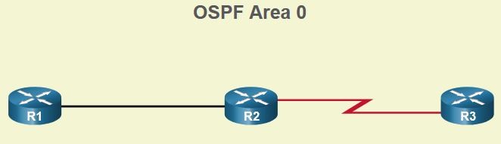
OSPF Features and Characteristics Single-Area and Multiarea OSPF
To make OSPF more efficient and scalable, OSPF supports hierarchical routing using areas. An OSPF area is a group of routers that share the same link-state information in their LSDBs. OSPF can be implemented in one of two ways, as follows:
Single-Area OSPF - All routers are in one area. Best practice is to use area 0.
Multiarea OSPF - OSPF is implemented using multiple areas, in a hierarchical fashion. All areas must connect to the backbone area (area 0). Routers interconnecting the areas are referred to as Area Border Routers (ABRs).
Notes:
1 - Single-Area OSPFv2 Concepts
1.1 - OSPF Features and Characteristics
1.1.4 - Single-Area and Multiarea OSPF

Slide 10
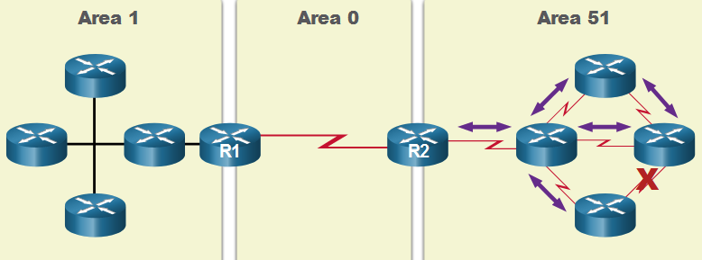
OSPF Features and Characteristics Multiarea OSPF
The hierarchical-topology design options with multiarea OSPF can offer the following advantages.
Smaller routing tables - Tables are smaller because there are fewer routing table entries. This is because network addresses can be summarized between areas. Route summarization is not enabled by default.
Reduced link-state update overhead - Designing multiarea OSPF with smaller areas minimizes processing and memory requirements.
Reduced frequency of SPF calculations -– Multiarea OSPF localize the impact of a topology change within an area. For instance, it minimizes routing update impact because LSA flooding stops at the area boundary.
Notes:
1 - Single-Area OSPFv2 Concepts
1.1 - OSPF Features and Characteristics
1.1.5 - Multiarea OSPF

Slide 11
OSPF Features and Characteristics OSPFv3
OSPFv3 is the OSPFv2 equivalent for exchanging IPv6 prefixes. OSPFv3 exchanges routing information to populate the IPv6 routing table with remote prefixes.
OSPFv3 has the same functionality as OSPFv2, but uses IPv6 as the network layer transport, communicating with OSPFv3 peers and advertising IPv6 routes. OSPFv3 also uses the SPF algorithm as the computation engine to determine the best paths throughout the routing domain.
OSPFv3 has separate processes from its IPv4 counterpart. The processes and operations are basically the same as in the IPv4 routing protocol, but run independently.
Notes:
1 - Single-Area OSPFv2 Concepts
1.1 - OSPF Features and Characteristics
1.1.6 - OSPFv3
1.1.7 - Check Your Understanding - OSPF Features and Characteristics

Slide 12
8.2 OSPF Packets
Notes:
1 - Single-Area OSPFv2 Concepts
1.2 - OSPF Packets

Slide 13
OSPF Packets Types of OSPF Packets
The table summarizes the five different types of Link State Packets (LSPs) used by OSPFv2. OSPFv3 has similar packet types.
Type | Packet Name | Description
1 | Hello | Discovers neighbors and builds adjacencies between them
2 | Database Description (DBD) | Checks for database synchronization between routers
3 | Link-State Request (LSR) | Requests specific link-state records from router to router
4 | Link-State Update (LSU) | Sends specifically requested link-state records
5 | Link-State Acknowledgment (LSAck) | Acknowledges the other packet types
Notes:
1 - Single-Area OSPFv2 Concepts
1.2 - OSPF Packets
1.2.2 – Types of OSPF Packets

Slide 14
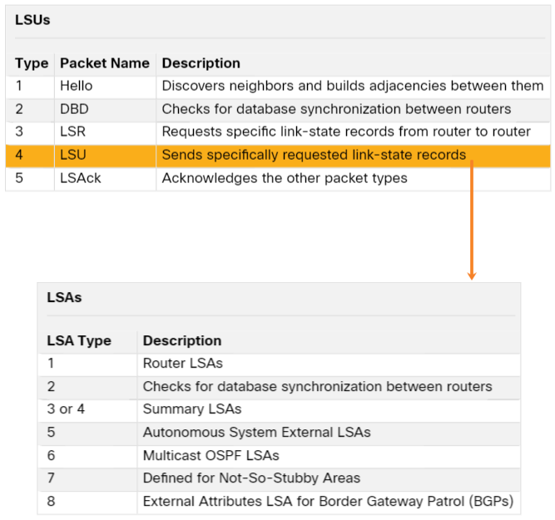
OSPF Packets Link-State Updates
LSUs are also used to forward OSPF routing updates. An LSU packet can contain 11 different types of OSPFv2 LSAs. OSPFv3 renamed several of these LSAs and also contains two additional LSAs.
LSU and LSA are often used interchangeably, but the correct hierarchy is LSU packets contain LSA messages.
Notes:
1 - Single-Area OSPFv2 Concepts
1.2 - OSPF Packets
1.2.3 – Link-State Updates

Slide 15
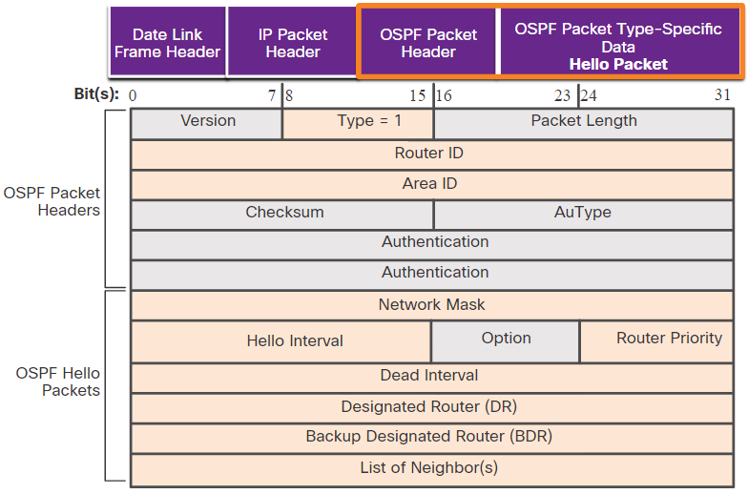
OSPF Packets Hello Packet
The OSPF Type 1 packet is the Hello packet. Hello packets are used to do the following:
Discover OSPF neighbors and establish neighbor adjacencies.
Advertise parameters on which two routers must agree to become neighbors.
Elect the Designated Router (DR) and Backup Designated Router (BDR) on multiaccess networks like Ethernet. Point-to-point links do not require DR or BDR.
Notes:
1 - Single-Area OSPFv2 Concepts
1.2 - OSPF Packets
1.2.4 – Hello Packet
1.2.5 – Check Your Understanding – OSPF Packets

Slide 16
8.3 OSPF Operation
Notes:
1 - Single-Area OSPFv2 Concepts
1.3 - OSPF Operation

Slide 17
OSPF Operation OSPF Operational States
State | Description
Down State | No Hello packets received = Down. Router sends Hello packets. Transition to Init state.
Init State | Hello packets are received from the neighbor. They contain the Router ID of the sending router. Transition to Two-Way state.
Two-Way State | In this state, communication between the two routers is bidirectional. On multiaccess links, the routers elect a DR and a BDR. Transition to ExStart state.
Notes:
1 - Single-Area OSPFv2 Concepts
1.3 - OSPF Operation
1.3.2 - OSPF Operational States

Slide 18
OSPF Operation OSPF Operational States (Cont.)
State | Description
ExStart State | On point-to-point networks, the two routers decide which router will initiate the DBD packet exchange and decide upon the initial DBD packet sequence number.
Exchange State | Routers exchange DBD packets. If additional router information is required then transition to Loading; otherwise, transition to the Full state.
Loading State | LSRs and LSUs are used to gain additional route information. Routes are processed using the SPF algorithm. Transition to the Full state.
Full State | The link-state database of the router is fully synchronized.
Notes:
1 - Single-Area OSPFv2 Concepts
1.3 - OSPF Operation
1.3.2 - OSPF Operational States (Cont.)

Slide 19
OSPF Operation Establish Neighbor Adjacencies
To determine if there is an OSPF neighbor on the link, the router sends a Hello packet that contains its router ID out all OSPF-enabled interfaces. The Hello packet is sent to the reserved All OSPF Routers IPv4 multicast address 224.0.0.5. Only OSPFv2 routers will process these packets.
The OSPF router ID is used by the OSPF process to uniquely identify each router in the OSPF area. A router ID is a 32-bit number formatted like an IPv4 address and assigned to uniquely identify a router among OSPF peers.
When a neighboring OSPF-enabled router receives a Hello packet with a router ID that is not within its neighbor list, the receiving router attempts to establish an adjacency with the initiating router.
Notes:
1 - Single-Area OSPFv2 Concepts
1.3 - OSPF Operation
1.3.3 - Establish Neighbor Adjacencies

Slide 20
OSPF Operation Establish Neighbor Adjacencies (Cont.)
The process routers use to establish adjacency on a multiaccess network:
1 | Down to Init State | When OSPFv2 is enabled on the interface, R1 transitions from Down to Init and starts sending OSPFv2 Hellos out of the interface in an attempt to discover neighbors.
2 | Init State | When a R2 receives a hello from the previously unknown router R1, it adds R1’s router ID to the neighbor list and responds with a Hello packet containing its own router ID.
3 | Two-Way State | R1 receives R2’s hello and notices that the message contains the R1 router ID in the list of R2’s neighbors. R1 adds R2’s router ID to the neighbor list and transitions to the Two-Way State. If R1 and R2 are connected with a point-to-point link, they transition to ExStart If R1 and R2 are connected over a common Ethernet network, the DR/BDR election occurs.
4 | Elect the DR & BDR | The DR and BDR election occurs, where the router with the highest router ID or highest priority is elected as the DR, and second highest is the BDR
Notes:
1 - Single-Area OSPFv2 Concepts
1.3 - OSPF Operation
1.3.3 - Establish Neighbor Adjacencies (Cont.)

Slide 21
OSPF Operation Synchronizing OSPF Databases
After the Two-Way state, routers transition to database synchronization states. This is a three step process, as follows:
Decide first router: The router with the highest router ID sends its DBD first.
Exchange DBDs: As many as needed to convey the database. The other router must acknowledge each DBD with an LSAck packet.
Send an LSR: Each router compares the DBD information with the local LSDB. If the DBD has more current link information, the router transitions to the loading state.
After all LSRs have been exchanged and satisfied, the routers are considered synchronized and in a full state. Updates (LSUs) are sent:
When a change is perceived (incremental updates)
Every 30 minutes
Notes:
1 - Single-Area OSPFv2 Concepts
1.3 - OSPF Operation
1.3.4 - Synchronizing OSPF Databases

Slide 22
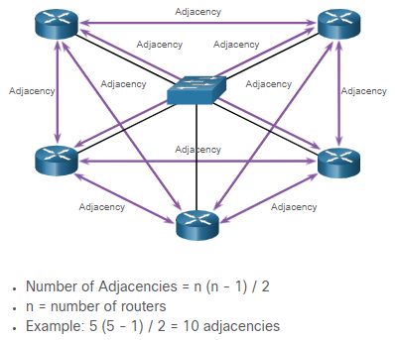
OSPF Operation The Need for a DR
Multiaccess networks can create two challenges for OSPF regarding the flooding of LSAs, as follows:
Creation of multiple adjacencies - Ethernet networks could potentially interconnect many OSPF routers over a common link. Creating adjacencies with every router would lead to an excessive number of LSAs exchanged between routers on the same network.
Extensive flooding of LSAs - Link-state routers flood their LSAs any time OSPF is initialized, or when there is a change in the topology. This flooding can become excessive.
Notes:
1 - Single-Area OSPFv2 Concepts
1.3 - OSPF Operation
1.3.5 – The Need for a DR

Slide 23
OSPF Operation LSA Flooding with a DR
An increase in the number of routers on a multiaccess network also increases the number of LSAs exchanged between the routers. This flooding of LSAs significantly impacts the operation of OSPF.
If every router in a multiaccess network had to flood and acknowledge all received LSAs to all other routers on that same multiaccess network, the network traffic would become quite chaotic.
On multiaccess networks, OSPF elects a DR to be the collection and distribution point for LSAs sent and received. A BDR is also elected in case the DR fails. All other routers become DROTHERs. A DROTHER is a router that is neither the DR nor the BDR.
Note: The DR is only used for the dissemination of LSAs. The router will still use the best next-hop router indicated in the routing table for the forwarding of all other packets.
Notes:
1 - Single-Area OSPFv2 Concepts
1.3 - OSPF Operation
1.3.6 - LSA Flooding with a DR
1.3.7 – Check Your Understanding – OSPF Operation

Slide 24
8.4 OSPF Router ID
Notes:
2 - Single-Area OSPFv2 Configuration
2.1 - OSPF Router ID

Slide 25
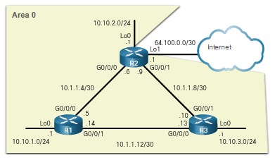
OSPF Router ID OSPF Reference Topology
The figure shows the topology used for configuring OSPFv2 in this module. The routers in the topology have a starting configuration, including interface addresses. There is currently no static routing or dynamic routing configured on any of the routers. All interfaces on R1, R2, and R3 (except the loopback 1 on R2) are within the OSPF backbone area. The ISP router is used as the gateway to the internet of the routing domain.
Notes:
2 - Single-Area OSPFv2 Configuration
2.1 - OSPF Router ID
2.1.1 - OSPF Reference Topology

Slide 26
OSPF Router ID Router Configuration Mode for OSPF
OSPFv2 is enabled using the router ospf process-id global configuration mode command. The process-id value represents a number between 1 and 65,535 and is selected by the network administrator. The process-id value is locally significant. It is considered best practice to use the same process-id on all OSPF routers.
R1(config)# router ospf 10
R1(config-router)# ?
area OSPF area parameters
auto-cost Calculate OSPF interface cost according to bandwidth
default-information Control distribution of default information
distance Define an administrative distance
exit Exit from routing protocol configuration mode
log-adjacency-changes Log changes in adjacency state
neighbor Specify a neighbor router
network Enable routing on an IP network
no Negate a command or set its defaults
passive-interface Suppress routing updates on an interface
redistribute Redistribute information from another routing protocol
router-id router-id for this OSPF process
R1(config-router)#
Notes:
2 - Single-Area OSPFv2 Configuration
2.1 - OSPF Router ID
2.1.2 - Router Configuration Mode for OSPF

Slide 27
OSPF Router ID Router IDs
An OSPF router ID is a 32-bit value, represented as an IPv4 address. It is used to uniquely identify an OSPF router, and all OSPF packets include the router ID of the originating router.
Every router requires a router ID to participate in an OSPF domain. It can be defined by an administrator or automatically assigned by the router. The router ID is used by an OSPF-enabled router to do the following:
Participate in the synchronization of OSPF databases – During the Exchange State, the router with the highest router ID will send their database descriptor (DBD) packets first.
Participate in the election of the designated router (DR) - In a multiaccess LAN environment, the router with the highest router ID is elected the DR. The routing device with the second highest router ID is elected the backup designated router (BDR).
Notes:
2 - Single-Area OSPFv2 Configuration
2.1 - OSPF Router ID
2.1.3 - Router IDs

Slide 28
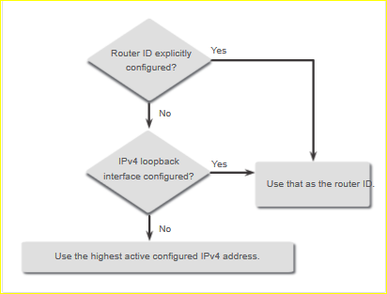
OSPF Router ID Router ID Order of Precedence
Cisco routers derive the router ID based on one of three criteria, in the following preferential order:
The router ID is explicitly configured using the OSPF router-id rid router configuration mode command. This is the recommended method to assign a router ID.
The router chooses the highest IPv4 address of any of configured loopback interfaces.
The router chooses the highest active IPv4 address of any of its physical interfaces.
Notes:
2 - Single-Area OSPFv2 Configuration
2.1 - OSPF Router ID
2.1.4 - Router ID Order of Precedence

Slide 29
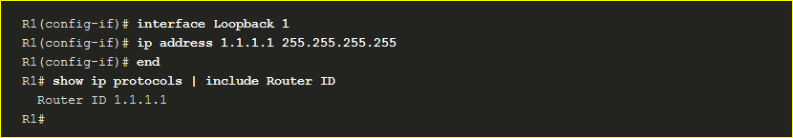
OSPF Router ID Configure a Loopback Interface as the Router ID
Instead of relying on physical interface, the router ID can be assigned to a loopback interface. Typically, the IPv4 address for this type of loopback interface should be configured using a 32-bit subnet mask (255.255.255.255). This effectively creates a host route. A 32-bit host route would not get advertised as a route to other OSPF routers.
OSPF does not need to be enabled on an interface for that interface to be chosen as the router ID.
Notes:
2 - Single-Area OSPFv2 Configuration
2.1 - OSPF Router ID
2.1.5 – Configure a Loopback Interface as the Router ID

Slide 30
OSPF Router ID Explicitly Configure a Router ID
In our reference topology the router ID for each router is assigned as follows:
R1 uses router ID 1.1.1.1
R2 uses router ID 2.2.2.2
R3 uses router ID 3.3.3.3
Use the router-id rid router configuration mode command to manually assign a router ID. In the example, the router ID 1.1.1.1 is assigned to R1. Use the show ip protocols command to verify the router ID.
R1(config)# router ospf 10
R1(config-router)# router-id 1.1.1.1
R1(config-router)# end
*May 23 19:33:42.689: %SYS-5-CONFIG_I: Configured from console by console
R1# show ip protocols | include Router ID
Router ID 1.1.1.1
R1#
Notes:
2 - Single-Area OSPFv2 Configuration
2.1 - OSPF Router ID
2.1.5 - Configure a Loopback Interface as the Router ID

Slide 31
OSPF Router ID Modify a Router ID
After a router selects a router ID, an active OSPF router does not allow the router ID to be changed until the router is reloaded or the OSPF process is reset.
Clearing the OSPF process is the preferred method to reset the router ID.
R1# show ip protocols | include Router ID
Router ID 10.10.1.1
R1# conf t
Enter configuration commands, one per line. End with CNTL/Z.
R1(config)# router ospf 10
R1(config-router)# router-id 1.1.1.1
% OSPF: Reload or use "clear ip ospf process" command, for this to take effect
R1(config-router)# end
R1# clear ip ospf process
Reset ALL OSPF processes? [no]: y
*Jun 6 01:09:46.975: %OSPF-5-ADJCHG: Process 10, Nbr 3.3.3.3 on GigabitEthernet0/0/1 from FULL to DOWN, Neighbor Down: Interface down or detached
*Jun 6 01:09:46.981: %OSPF-5-ADJCHG: Process 10, Nbr 3.3.3.3 on GigabitEthernet0/0/1 from LOADING to FULL, Loading Done *
R1# show ip protocols | include Router ID
Router ID 1.1.1.1
R1#
Notes:
2 - Single-Area OSPFv2 Configuration
2.1 - OSPF Router ID
2.1.7 - Modify a Router ID
2.1.8 - Syntax Checker - Configure R2 and R3 Router IDs
2.1.9 - Check Your Understanding - OSPF Router ID

Slide 32
8.4 Point-to-Point OSPF Networks
Notes:
2 - Single-Area OSPFv2 Configuration
2.2 - Point-to-Point OSPF Networks

Slide 33
Point-to-Point OSPF Networks The network Command Syntax
You can specify the interfaces that belong to a point-to-point network by configuring the network command. You can also configure OSPF directly on the interface with the ip ospf command.
The basic syntax for the network command is as follows:
Router(config-router)# network network-address wildcard-mask area area-id
The network-address wildcard-mask syntax is used to enable OSPF on interfaces. Any interfaces on a router that match this part of the command are enabled to send and receive OSPF packets.
The area area-id syntax refers to the OSPF area. When configuring single-area OSPFv2, the network command must be configured with the same area-id value on all routers. Although any area ID can be used, it is good practice to use an area ID of 0 with single-area OSPFv2. This convention makes it easier if the network is later altered to support multiarea OSPFv2.
Notes:
2 - Single-Area OSPFv2 Configuration
2.2 - Point-to-Point OSPF Networks
2.2.1 - The network Command Syntax

Slide 34
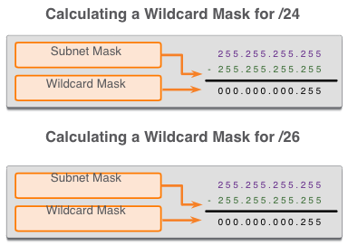
Point-to-Point OSPF Networks The Wildcard Mask
The wildcard mask is typically the inverse of the subnet mask configured on that interface.
The easiest method for calculating a wildcard mask is to subtract the network subnet mask from 255.255.255.255, as shown for /24 and /26 subnet masks in the figure.
Notes:
2 - Single-Area OSPFv2 Configuration
2.2 - Point-to-Point OSPF Networks
2.2.2 - The Wildcard Mask
2.2.3 - Check Your Understanding - The Wildcard Mask

Slide 35
Point-to-Point OSPF Networks Configure OSPF Using the network Command
Within routing configuration mode, there are two ways to identify the interfaces that will participate in the OSPFv2 routing process.
In the first example, the wildcard mask identifies the interface based on the network addresses. Any active interface that is configured with an IPv4 address belonging to that network will participate in the OSPFv2 routing process.
Note: Some IOS versions allow the subnet mask to be entered instead of the wildcard mask. The IOS then converts the subnet mask to the wildcard mask format.
R1(config)# router ospf 10
R1(config-router)# network 10.10.1.0 0.0.0.255 area 0
R1(config-router)# network 10.1.1.4 0.0.0.3 area 0
R1(config-router)# network 10.1.1.12 0.0.0.3 area 0
R1(config-router)#
Notes:
2 - Single-Area OSPFv2 Configuration
2.2 - Point-to-Point OSPF Networks
2.2.4 - Configure OSPF Using the network Command

Slide 36
Point-to-Point OSPF Networks Configure OSPF Using the network Command (Cont.)
As an alternative, OSPFv2 can be enabled by specifying the exact interface IPv4 address using a quad zero wildcard mask. Entering network 10.1.1.5 0.0.0.0 area 0 on R1 tells the router to enable interface Gigabit Ethernet 0/0/0 for the routing process.
The advantage of specifying the interface is that the wildcard mask calculation is not necessary. Notice that in all cases, the area argument specifies area 0.
R1(config)# router ospf 10
R1(config-router)# network 10.10.1.1 0.0.0.0 area 0
R1(config-router)# network 10.1.1.5 0.0.0.0 area 0
R1(config-router)# network 10.1.1.14 0.0.0.0 area 0
R1(config-router)#
Notes:
2 - Single-Area OSPFv2 Configuration
2.2 - Point-to-Point OSPF Networks
2.2.4 - Configure OSPF Using the network Command (Cont.)
2.2.5 - Syntax Checker - Configure R2 and R3 using the network Command

Slide 37
Point-to-Point OSPF Networks Configure OSPF Using the ip ospf Command
To configure OSPF directly on the interface, use the ip ospf interface configuration mode command. The syntax is as follows:
Router(config-if)# ip ospf process-id area area-id
Remove the network commands using the no form of the command. Then go to each interface and configure the ip ospf command
R1(config)# router ospf 10
R1(config-router)# no network 10.10.1.1 0.0.0.0 area 0
R1(config-router)# no network 10.1.1.5 0.0.0.0 area 0
R1(config-router)# no network 10.1.1.14 0.0.0.0 area 0
R1(config-router)# interface GigabitEthernet 0/0/0
R1(config-if)# ip ospf 10 area 0
R1(config-if)# interface GigabitEthernet 0/0/1
R1(config-if)# ip ospf 10 area 0
R1(config-if)# interface Loopback 0
R1(config-if)# ip ospf 10 area 0
R1(config-if)#
Notes:
2 - Single-Area OSPFv2 Configuration
2.2 - Point-to-Point OSPF Networks
2.2.6 - Configure OSPF Using the ip ospf Command
2.2.7 - Syntax Checker - Configure R2 and R3 using the ip ospf Command

Slide 38
Point-to-Point OSPF Networks Passive Interface
By default, OSPF messages are forwarded out all OSPF-enabled interfaces. However, these messages only need to be sent out interfaces that are connecting to other OSPF-enabled routers.
Sending out unneeded messages on a LAN affects the network in three ways:
Inefficient Use of Bandwidth - Available bandwidth is consumed transporting unnecessary messages.
Inefficient Use of Resources - All devices on the LAN must process and eventually discard the message.
Increased Security Risk - Without additional OSPF security configurations, OSPF messages can be intercepted with packet sniffing software. Routing updates can be modified and sent back to the router, corrupting the routing table with false metrics that misdirect traffic.
Notes:
2 - Single-Area OSPFv2 Configuration
2.2 - Point-to-Point OSPF Networks
2.2.8 - Passive Interface

Slide 39
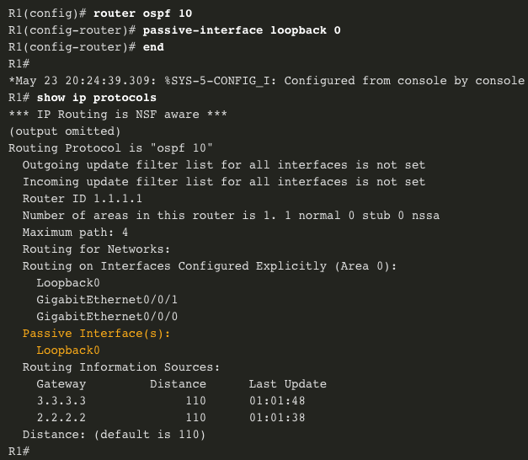
Point-to-Point OSPF Networks Configure Passive Interfaces
Use the passive-interface router configuration mode command to prevent the transmission of routing messages through a router interface, but still allow that network to be advertised to other routers.
The show ip protocols command is then used to verify that the interface is listed as passive.
Notes:
2 - Single-Area OSPFv2 Configuration
2.2 - Point-to-Point OSPF Networks
2.2.9 - Configure Passive Interfaces
2.2.10 - Syntax Checker - Configure R2 and R3 Passive Interfaces

Slide 40
Point-to-Point OSPF Networks OSPF Point-to-Point Networks
By default, Cisco routers elect a DR and BDR on Ethernet interfaces, even if there is only one other device on the link. You can verify this with the show ip ospf interface command. The DR/ BDR election process is unnecessary as there can only be two routers on the point-to-point network between R1 and R2. Notice in the output that the router has designated the network type as BROADCAST.
R1# show ip ospf interface GigabitEthernet 0/0/0
GigabitEthernet0/0/0 is up, line protocol is up
Internet Address 10.1.1.5/30, Area 0, Attached via Interface Enable
Process ID 10, Router ID 1.1.1.1, Network Type BROADCAST, Cost: 1
Topology-MTID Cost Disabled Shutdown Topology Name
0 1 no no Base
Enabled by interface config, including secondary ip addresses
Transmit Delay is 1 sec, State BDR, Priority 1
Designated Router (ID) 2.2.2.2, Interface address 10.1.1.6
Backup Designated router (ID) 1.1.1.1, Interface address 10.1.1.5
Timer intervals configured, Hello 10, Dead 40, Wait 40, Retransmit 5
oob-resync timeout 40
Notes:
2 - Single-Area OSPFv2 Configuration
2.2 - Point-to-Point OSPF Networks
2.2.11 - OSPF Point-to-Point Networks

Slide 41
Point-to-Point OSPF Networks OSPF Point-to-Point Networks (Cont.)
To change this to a point-to-point network, use the interface configuration command ip ospf network point-to-point on all interfaces where you want to disable the DR/BDR election process.
R1(config)# interface GigabitEthernet 0/0/0
R1(config-if)# ip ospf network point-to-point
*Jun 6 00:44:05.208: %OSPF-5-ADJCHG: Process 10, Nbr 2.2.2.2 on GigabitEthernet0/0/0 from FULL to DOWN, Neighbor Down: Interface down or detached
*Jun 6 00:44:05.211: %OSPF-5-ADJCHG: Process 10, Nbr 2.2.2.2 on GigabitEthernet0/0/0 from LOADING to FULL, Loading Done
R1(config-if)# end
R1# show ip ospf interface GigabitEthernet 0/0/0
GigabitEthernet0/0/0 is up, line protocol is up
Internet Address 10.1.1.5/30, Area 0, Attached via Interface Enable
Process ID 10, Router ID 1.1.1.1, Network Type POINT_TO_POINT, Cost: 1
Topology-MTID Cost Disabled Shutdown Topology Name
Notes:
2 - Single-Area OSPFv2 Configuration
2.2 - Point-to-Point OSPF Networks
2.2.11 - OSPF Point-to-Point Networks (Cont.)

Slide 42
Point-to-Point OSPF Networks Loopbacks and Point-to-Point Networks
Use loopbacks to provide additional interfaces for a variety of purposes. By default, loopback interfaces are advertised as /32 host routes.
To simulate a real LAN, the loopback interface can be configured as a point-to-point network to advertise the full network.
What R2 sees when R1 advertises the loopback interface as-is:
R2# show ip route | include 10.10.1
O 10.10.1.1/32 [110/2] via 10.1.1.5, 00:03:05, GigabitEthernet0/0/0
Configuration change at R1:
R1(config-if)# interface Loopback 0
R1(config-if)# ip ospf network point-to-point
Result at R2:
R2# show ip route | include 10.10.1
O 10.10.1.0/24 [110/2] via 10.1.1.5, 00:03:05, GigabitEthernet0/0/0
Notes:
2 - Single-Area OSPFv2 Configuration
2.2 - Point-to-Point OSPF Networks
2.2.12 - Loopbacks and Point-to-Point Networks

Slide 43
8.5 Modify Single-Area OSPFv2
Notes:
2 - Single-Area OSPFv2 Configuration
2.4 - Modify Single-Area OSPFv2

Slide 44
Modify Single-Area OSPFv2 Cisco OSPF Cost Metric
Routing protocols use a metric to determine the best path of a packet across a network. OSPF uses cost as a metric. A lower cost indicates a better path.
The Cisco cost of an interface is inversely proportional to the bandwidth of the interface. Therefore, a higher bandwidth indicates a lower cost. The formula used to calculate the OSPF cost is:
Cost = reference bandwidth / interface bandwidth
The default reference bandwidth is 10⁸ (100,000,000); therefore, the formula is:
Cost = 100,000,000 bps / interface bandwidth in bps
Because the OSPF cost value must be an integer, FastEthernet, Gigabit Ethernet, and 10 GigE interfaces share the same cost. To correct this situation, you can:
Adjust the reference bandwidth with the auto-cost reference-bandwidth command on each OSPF router.
Manually set the OSPF cost value with the ip ospf cost command on necessary interfaces.
Notes:
2 - Single-Area OSPFv2 Configuration
2.4 - Modify Single-Area OSPFv2
2.4.1 - Cisco OSPF Cost Metric

Slide 45
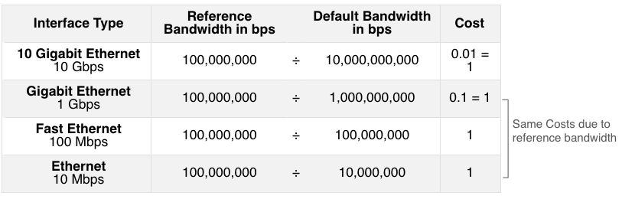
Modify Single-Area OSPFv2 Cisco OSPF Cost Metric (Cont.)
Refer to the table for a breakdown of the cost calculation
Notes:
2 - Single-Area OSPFv2 Configuration
2.4 - Modify Single-Area OSPFv2
2.4.1 - Cisco OSPF Cost Metric (Cont.)

Slide 46
Modify Single-Area OSPFv2 Adjust the Reference Bandwidth
The cost value must be an integer. If something less than an integer is calculated, OSPF rounds up to the nearest integer. Therefore, the OSPF cost assigned to a Gigabit Ethernet interface with the default reference bandwidth of 100,000,000 bps would equal 1, because the nearest integer for 0.1 is 0 instead of 1.
Cost = 100,000,000 bps / 1,000,000,000 = 1
For this reason, all interfaces faster than Fast Ethernet will have the same cost value of 1 as a Fast Ethernet interface.
To assist OSPF in making the correct path determination, the reference bandwidth must be changed to a higher value to accommodate networks with links faster than 100 Mbps.
Notes:
2 - Single-Area OSPFv2 Configuration
2.4 - Modify Single-Area OSPFv2
2.4.2 - Adjust the Reference Bandwidth

Slide 47
Modify Single-Area OSPFv2 Adjust the Reference Bandwidth (Cont.)
Changing the reference bandwidth does not actually affect the bandwidth capacity on the link; rather, it simply affects the calculation used to determine the metric.
To adjust the reference bandwidth, use the auto-cost reference-bandwidth Mbps router configuration command.
This command must be configured on every router in the OSPF domain.
Notice in the command that the value is expressed in Mbps; therefore, to adjust the costs for Gigabit Ethernet, use the command auto-cost reference-bandwidth 1000. For 10 Gigabit Ethernet, use the command auto-cost reference-bandwidth 10000.
To return to the default reference bandwidth, use the auto-cost reference-bandwidth 100 command.
Another option is to change the cost on one specific interface using the ip ospf cost cost command.
Notes:
2 - Single-Area OSPFv2 Configuration
2.4 - Modify Single-Area OSPFv2
2.4.2 - Adjust the Reference Bandwidth (Cont.)

Slide 48
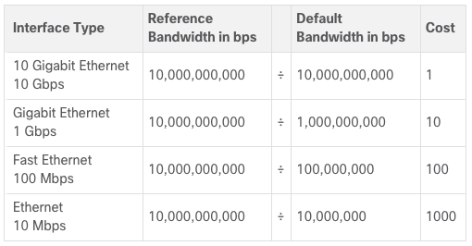
Modify Single-Area OSPFv2 Adjust the Reference Bandwidth (Cont.)
Whichever method is used, it is important to apply the configuration to all routers in the OSPF routing domain.
The table shows the OSPF cost if the reference bandwidth is adjusted to accommodate 10 Gigabit Ethernet links. The reference bandwidth should be adjusted anytime there are links faster than FastEthernet (100 Mbps).
Use the show ip ospf interface command to verify the current OSPFv2 cost assigned to the interface.
Notes:
2 - Single-Area OSPFv2 Configuration
2.4 - Modify Single-Area OSPFv2
2.4.2 - Adjust the Reference Bandwidth (Cont.)

Slide 49
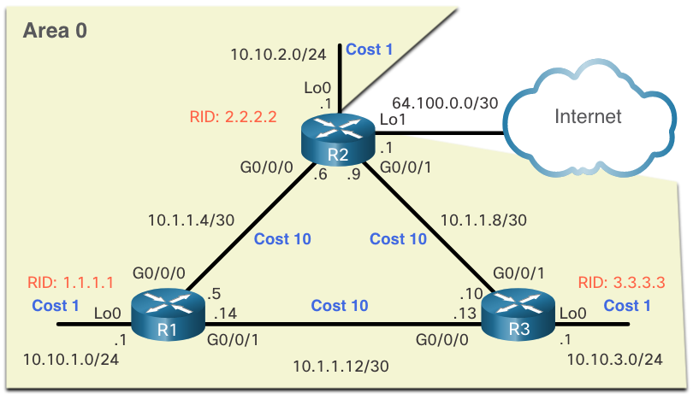
Modify Single-Area OSPFv2 OSPF Accumulates Cost
The cost of an OSPF route is the accumulated value from one router to the destination network.
Assuming the auto-cost reference-bandwidth 10000 command has been configured on all three routers, the cost of the links between each router is now 10. The loopback interfaces have a default cost of 1.
Notes:
2 - Single-Area OSPFv2 Configuration
2.4 - Modify Single-Area OSPFv2
2.4.3 - OSPF Accumulates Cost

Slide 50
Modify Single-Area OSPFv2 OSPF Accumulates Cost (Cont.)
You can calculate the cost for each router to reach each network.
For example, the total cost for R1 to reach the 10.10.2.0/24 network is 11. This is because the link to R2 cost = 10 and the loopback default cost = 1. 10 + 1 = 11.
You can verify this with the show ip route command.
Notes:
2 - Single-Area OSPFv2 Configuration
2.4 - Modify Single-Area OSPFv2
2.4.3 - OSPF Accumulates Cost (Cont.)

Slide 51
Modify Single-Area OSPFv2 OSPF Accumulates Cost (Cont.)
Verifying the accumulated cost for the path to the 10.10.2.0/24 network:
R1# show ip route | include 10.10.2.0
O 10.10.2.0/24 [110/11] via 10.1.1.6, 01:05:02, GigabitEthernet0/0/0
R1# show ip route 10.10.2.0
Routing entry for 10.10.2.0/24
Known via "ospf 10", distance 110, metric 11, type intra area
Last update from 10.1.1.6 on GigabitEthernet0/0/0, 01:05:13 ago
Routing Descriptor Blocks:
* 10.1.1.6, from 2.2.2.2, 01:05:13 ago, via GigabitEthernet0/0/0
Route metric is 11, traffic share count is 1
R1#
Notes:
2 - Single-Area OSPFv2 Configuration
2.4 - Modify Single-Area OSPFv2
2.4.3 - OSPF Accumulates Cost (Cont.)

Slide 52
Modify Single-Area OSPFv2 Manually Set OSPF Cost Value
Reasons to manually set the cost value include:
The Administrator may want to influence path selection within OSPF, causing different paths to be selected than what normally would given default costs and cost accumulation.
Connections to equipment from other vendors who use a different formula to calculate OSPF cost.
To change the cost value reported by the local OSPF router to other OSPF routers, use the interface configuration command ip ospf cost value.
R1(config)# interface g0/0/1 R1(config-if)# ip ospf cost 30 R1(config-if)# interface lo0 R1(config-if)# ip ospf cost 10 R1(config-if)# end
R1#
Notes:
2 - Single-Area OSPFv2 Configuration
2.4 - Modify Single-Area OSPFv2
2.4.4 - Manually Set OSPF Cost Value

Slide 53
8.6 Single-Area OSPFv3
Notes:
8 – Single-Area OSPF
8.3 – Single-Area OSPFv3

Slide 54
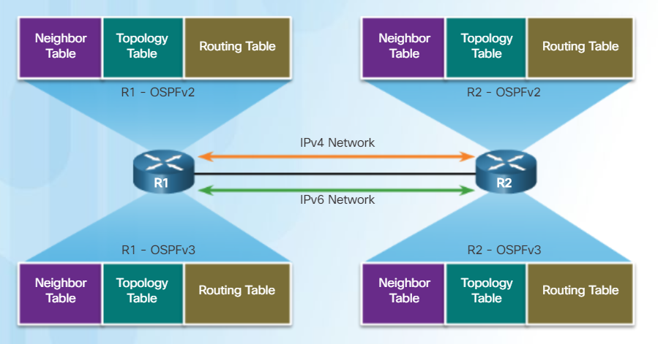
OSPFv2 vs. OSPFv3 OSPFv3
OSPFv3 is used to exchange IPv6 prefixes and build an IPv6 routing table.
OSPFv3 builds three OSPF tables – neighbor table, topology table, and routing table.
Notes:
8.3 – Single-Area OSPFv3
8.3.1 – OSPFv2 vs. OSPFv3
8.3.1.1 – OSPFv3

Slide 55
OSPFv2 vs. OSPFv3 Similarities Between OSPFv2 and OSPFv3
Feature | Comments
Link-State | Both are this type of routing protocol
Routing algorithm | Shortest Path First (SPF)
Metric | Cost
Areas | Both use and support a two-level hierarchy with areas connecting to Area 0
Packet types | Both use the same Hello, DBD, LSR, LSU, and LSAck packets
Neighbor discovery | Transitions through the same states using Hello packets
DR/BDR | Function and election process is the same
Router ID | Both use a 32-bit router ID; determined by the same process
Notes:
8.3 – Single-Area OSPFv3
8.3.1 – OSPFv2 vs. OSPFv3
8.3.1.2 – Similarities Between OSPFv2 to OSPFv3

Slide 56
OSPFv2 vs. OSPFv3 Differences Between OSPFv2 and OSPFv3
Feature | OSPFv2 | OSPFv3
Advertisements | IPv4 networks | IPv6 prefixes
Source address | IPv4 source address | IPv6 link-local address
Destination address | Choice of: Neighbor IPv4 unicast address 224.0.0.5 all-OSPF-routers multicast address 224.0.0.6 DR/BDR multicast address | Choice of: Neighbor IPv6 link-local address FF02::5 all-OSPF-routers multicast address FF02::6 DR/BDR multicast address
Advertise networks | Configured using the network router configuration command | Configured using the ipv6 ospf process-id area area-id interface configuration command
IP unicast routing | IPv4 unicast routing is enabled by default | IPv6 unicast forwarding is not enabled by default. Use the ipv6 unicast-routing global configuration command to enable.
Authentication | Plain text and MD5 | IPv6 authentication (IPsec)
Notes:
8.3 – Single-Area OSPFv3
8.3.1 – OSPFv2 vs. OSPFv3
8.3.1.3 – Differences Between OSPFv2 and OSPFv3

Slide 57
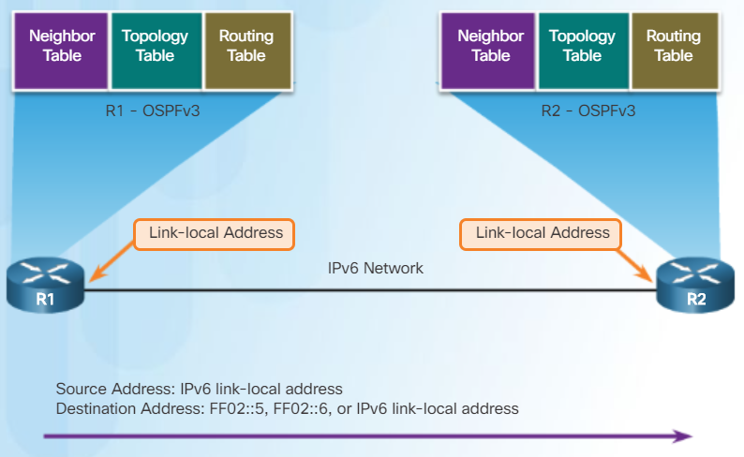
OSPFv2 vs. OSPFv3 Link-Local Addresses
An IPv6-link-local address enables a device to communicate with other IPv6-enabled devices on the same link and only on that link (subnet).
Packets with a source or destination link-local address cannot be routed beyond the link from where the packet originated.
IPv6 link-local address are used to exchange OSPFv3 messages
Notes:
8.3 – Single-Area OSPFv3
8.3.1 – OSPFv2 vs. OSPFv3
8.3.1.4 – Link-Local Addresses

Slide 58
Configuring OSPFv3 OSPFv3 Network Topology (Cont.)
Steps to Configure OSPFv3
Enable IPv6 unicast routing in global configuration mode – ipv6 unicast-routing
(Optional) Configure link-local addresses.
Configure a 32-bit router ID in OSPFv3 router configuration mode – router-id rid
Configure optional routing specifics such as adjusting the reference bandwidth.
(Optional, but optimum) Configure OSPFv3 interface specific settings such as setting the interface bandwidth on serial links.
Enable OSPFv3 routing in interface configuration mode – ipv6 ospf area
Notes:
8.3 – Single-Area OSPFv3
8.3.2 – Configuring OSPFv3
8.3.2.1 – OSPFv3 Network Topology (Cont.)

Slide 59
8.7 Verifying OSPF
Notes:
8 – Single-Area OSPF
8.3 – Single-Area OSPFv3

Slide 60
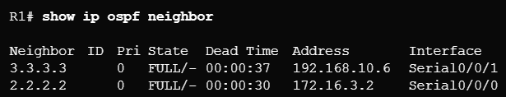
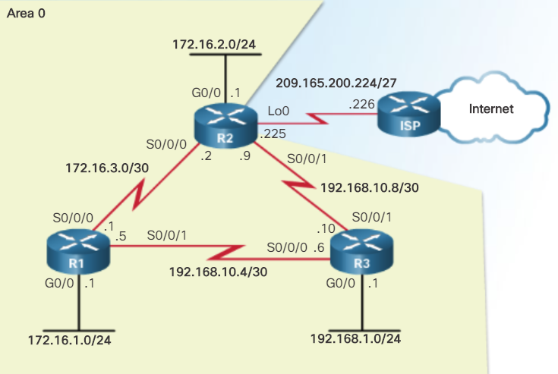
Verify OSPF Verify OSPF Neighbors
Use the show ip ospf neighbor to verify the router has formed an adjacency with a directly-connected router.
Output | Description
Neighbor ID | The router ID of the neighbor router
Pri | The OSPFv2 priority of the interface used in the DR/BDR election process
State | The OSPFv2 state – Full means that the link-state database has had the algorithm executed and the neighbor router and R1 have identical LSDBs. Ethernet multi-access interfaces may show as 2WAY. The dash indicates that no DR/BDR is required.
Dead time | Amount of time remaining before expecting to receive a hello packet from the neighbor before declaring the neighbor down. This value is reset when a hello packet is received.
Address | The address of the neighbor’s directly-connected interface
Interface | The interface on R1 used to form an adjacency with the neighbor router
Notes:
8.2 – Single-Area OSPFv2
8.2.4 – Verify OSPF
8.2.4.1 – Verify OSPF Neighbors

Slide 61
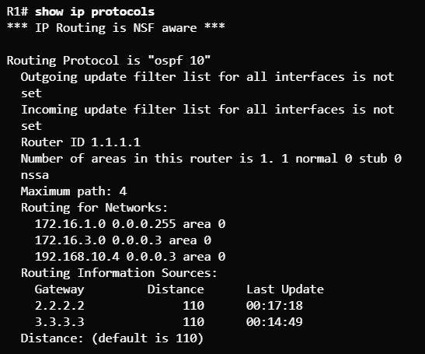
Verify OSPF Verify OSPF Protocol Settings
The show ip protocols command is used to verify the OSPFv2 process ID, router ID, networks being advertised by the router, neighbors that are sending OSPF updates, and the administrative distance (110 by default).
Notes:
8.2 – Single-Area OSPFv2
8.2.4 – Verify OSPF
8.2.4.2 – Verify OSPF Protocol Settings

Slide 62
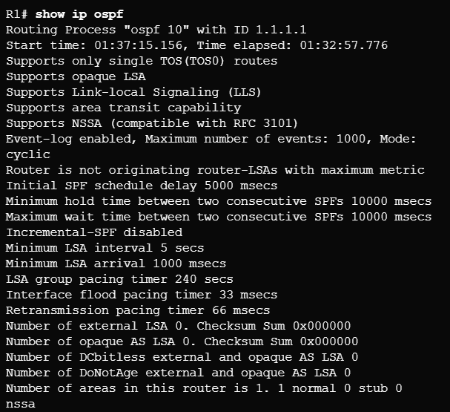
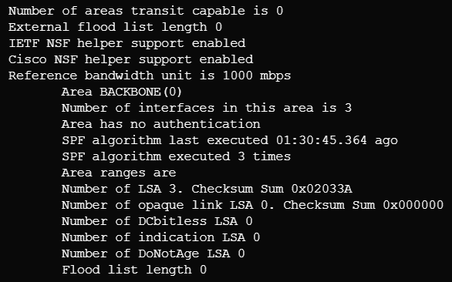
Verify OSPF Verify OSPF Process Information
The show ip ospf command is another way to see the OSPFv2 process ID and router ID.
Notes:
8.2 – Single-Area OSPFv2
8.2.4 – Verify OSPF
8.2.4.3 – Verify OSPF Process Information

Slide 63
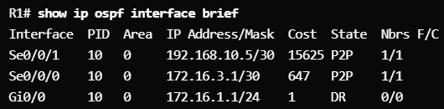
Verify OSPF Verify OSPF Interface Settings
Use the show ip ospf interface command to see details for every OSPFv2-enabled interface especially to see if the network statements were correctly composed.
Use the show ip ospf interface brief command to see key information about OSPFv2-enabled interfaces on a particular router.
Notes:
8.2 – Single-Area OSPFv2
8.2.4 – Verify OSPF
8.2.4.4 – Verify OSPF Interface settings

